Slide 1




Controllers and Markup
AngularJS basic components
SoftUni Team
Technical Trainers
Software University
http://softuni.bg

Slide 2

Table of Contents
Controllers and $scope
Directives
Expressions
Filters
Binding
Validation

Slide 3
Controllers & Scope
Controller
Scope
View

Slide 4
Controllers and Scope
Controller
Contains the logic
Responsible for creating the scope object
$scope object
Communication between controller and view
Binding between controller and view can be one-way or two-way
The scope contains the model

Slide 5
Controllers and Scope
Controller
View
Module name
var myApp = angular.module('myApp', []);
myApp.controller('myController',
function myController($scope, /* services */) {
$scope.name = "Vladimir";
});
Controller name
Scope is injected by Angular
Module I want to use
<div ng-app"myApp">
<div ng-controller="myController">
<h1>Hello, {{name}}!</h1>
</div>
</div>
Controller I want to use
Everything in scope is accessed via directives
Hello, Vladimir!

Slide 6
Controllers & Scope
Display basic user info
Display collections
Handling events
Live Demo

Slide 7
Constants and Values
Values
Constants
Constants is not the best practice. Use them wisely!
myApp.value('visitors', {
count: 4,
names: ['Nakov', 'Petya', 'Alex', 'Vlado']
});
myApp.constant('appConfig', {
'url': 'http://softuni.bg/',
'port': 8888
})

Slide 8

Directives
DOM Element's markers

Slide 9
What are directives?
Extends HTML Functionality
Angular's HTML compiler attached behaviour to DOM element
Start with ng
Angular directives can be written in several ways:
Like element name:
Like attribute:
Like CSS class:
<ng-form />
<div ng-form />
<div class="ng-form" />

Slide 10
ngChange
<input type="text"
ng-change="handleTextboxChange()"
ng-model="textBox" />
Live Demo

Slide 11
Event Directives
Mouse events
ngClick
ngDblClick
ngMousedown
ngMouseup
ngMouseenter
ngMouseleave
ngMousemove
ngMouseover

Slide 12

Mouse Events
Live Demo

Slide 13
Other Directives
ngApp
ngHide
ngClass
ngBind
ngShow
ngClassEven
ngBindTemplate
ngCloak
ngClassOdd
ngBindHtml
ngStyle
ngBindHtmlUnsafe

Slide 14
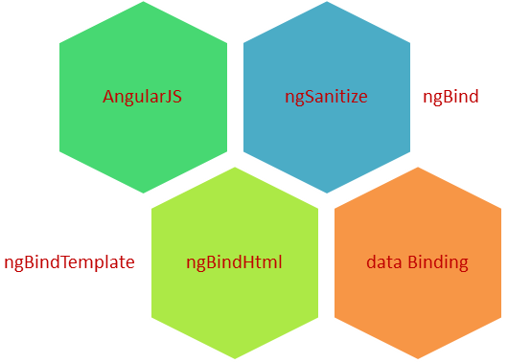
Bind Directives
Live Demo

Slide 15
Other Directives (2)
ngDisabled
ngForm
ngChecked
ngSubmit
ngMultiple
ngHref
ngReadonly
ngSrc
ngSelected
ngNonBindable

Slide 16

Other Directives
Live Demo

Slide 17


Directives - IE Restrictions
Older Internet Explorers do not support strange tags
What to do for older IEs:
Polyfill JSON.stringify
No NG tags
Use attribute or class directive's form
<ng-pluralize count="…" when="…"></ng-pluralize>
<div ng-pluralize count="…" when="…"></div>

Slide 18
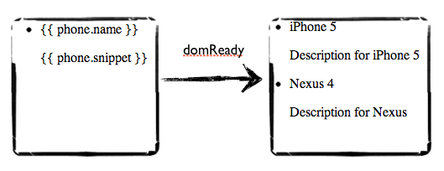

Expressions

Slide 19
Expressions
JavaScript-like code snippets placed in bindings:
Evaluated against a scope object
Trying to evaluate undefined properties doesn't throw an error
No control flow statements
Can use filters within expressions
{{ expression }}
<div>3*12={{ 3*12 }}</div> // 3*12=36
<div>{{ person.contacts.email }}</div>

Slide 20
Expressions
Live Demo

Slide 21

Filters

Slide 22
Filters
A filters formats the value of an expression
Modifying output
Formatting
Sorting data
Filtering data
Using filters:
{{ expression | filter }}

Slide 23
Built-In Filters
uppercase
lowercase
numbers
currency
date
json
orderBy
limitTo
filter

Slide 24
Writing Custom Filters
module.filter('name', function() {
return function(input, /* filter params */) {
// modify input
// return modifiedInput;
}
});

Slide 25
Filters
Live Demo

Slide 26
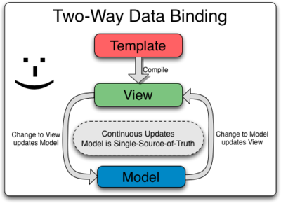
Two-Way Binding

Slide 27

Two-Way Binding
Using ngModel directive
It is working on:
input
select
textarea
<input type="text" ng-model="name" />
<input type="text" ng-model="person.contacts.phone" />

Slide 28

Validation

Slide 29
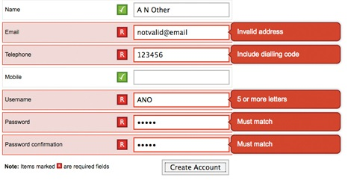
Validation
Validation directives
required – makes input field required
ngPattern – Added regex pattern
Form properties
$valid / $invalid
$dirty / $pristine
CSS Classes
You can style ng classes (ng-dirty, ng-valid, ng-required)

Slide 30
Validation
Live Demo

Slide 31


Summary
Can modules depend on other modules?
What is the primary responsibility of the controller?
Can the view bind to functions on the scope?
What are the ways directives can be written?
That is the purpose of the ngClock directive?
Which bind directive supports multiple bindings?
Do expressions support all JavaScript syntax?
Can you limit a filter to only search in specific field?
Which HTML elements work with two way binding?
SPA with AngularJS

Slide 32







SPA with AngularJS
https://softuni.bg/courses/spa-applications-angularjs

Slide 33
License
This course (slides, examples, demos, videos, homework, etc.) is licensed under the "Creative Commons Attribution-NonCommercial-ShareAlike 4.0 International" license
Attribution: this work may contain portions from
"SPA with AngularJS" course by Telerik Academy under CC-BY-NC-SA license

Slide 34





Free Trainings @ Software University
Software University Foundation – softuni.org
Software University – High-Quality Education, Profession and Job for Software Developers
softuni.bg
Software University @ Facebook
facebook.com/SoftwareUniversity
Software University @ YouTube
youtube.com/SoftwareUniversity
Software University Forums – forum.softuni.bg

